Slide 1

Databricks and Azure ML

Slide 2
What is MLflow?
MLflow is an open source platform for developing models and generative AI applications. It has the following primary components:
Tracking: Allows you to track experiments to record and compare parameters and results.
Models: Allow you to manage and deploy models from various ML libraries to various model serving and inference platforms.
Model Registry: Allows you to manage the model deployment process from staging to production, with model versioning and annotation capabilities.
AI agent evaluation and tracing: Allows you to develop high-quality AI agents by helping you compare, evaluate, and troubleshoot agents.

Slide 3
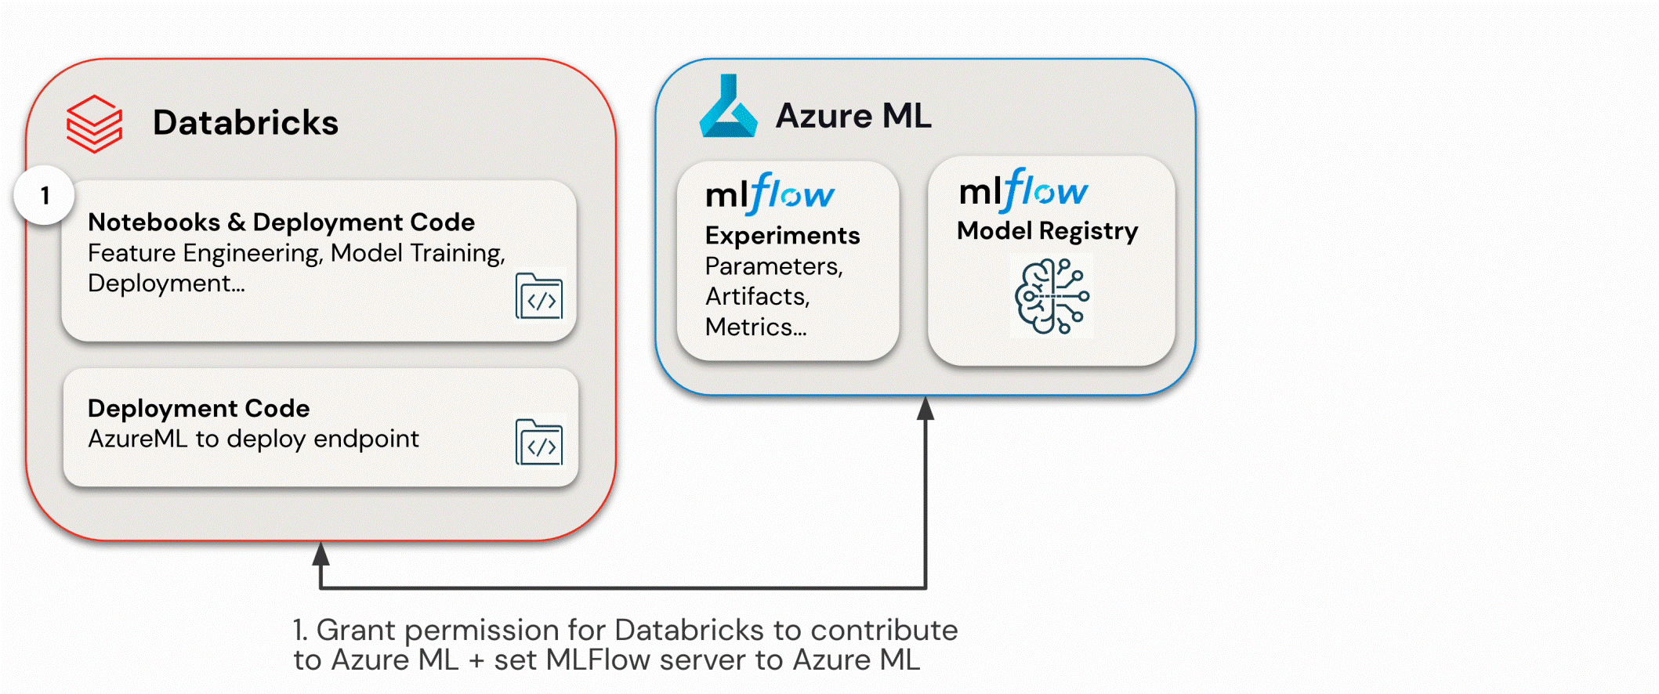
What is MLflow?

Slide 4
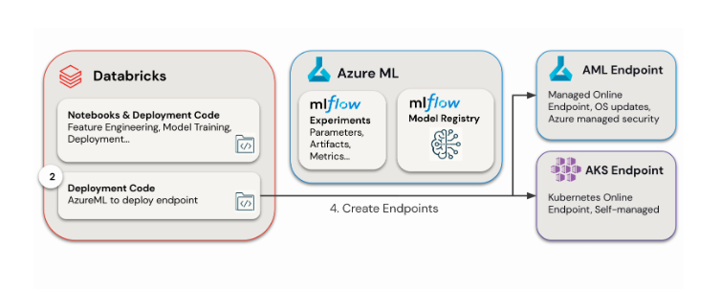
What is MLflow?

Slide 5
What is Databricks-managed MLflow ?
Databricks-managed MLflow is built on Unity Catalog and the Cloud Data Lake to unify all your data and AI assets in the ML lifecycle:
Feature store: Databricks automated feature lookups simplifies integration and reduces mistakes.
Train models: Use Mosaic AI to train models or fine-tune foundation models.
Tracking: MLflow tracks training by logging parameters, metrics, and artifacts to evaluate and compare model performance.
Model Registry: MLflow Model Registry, integrated with Unity Catalog centralizes AI models and artifacts.
Model Serving: Mosaic AI Model Serving deploys models to a REST API endpoint.
Monitoring: Mosaic AI Model Serving automatically captures requests and responses to monitor and debug models. MLflow augments this data with trace data for each request.

Slide 6
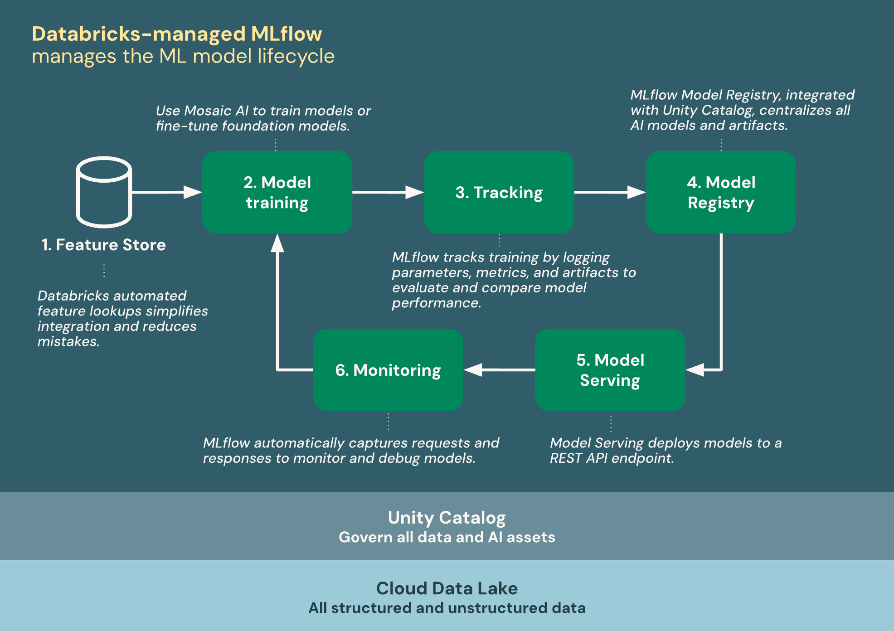
What is MLflow?
Databricks provides a fully managed and hosted version of MLflow, building on the open source experience to make it more robust and scalable for enterprise use.
The following diagram shows how Databricks integrates with MLflow to train and deploy machine learning models.

Slide 7
MLflow
MLflow already has the ability to track metrics, parameters, and artifacts as part of experiments; package models and reproducible ML projects; and deploy models to batch or real-time serving platforms.
Built on these existing capabilities, the MLflow Model Registry [AWS] [Azure] provides a central repository to manage the model deployment lifecycle.

Slide 8
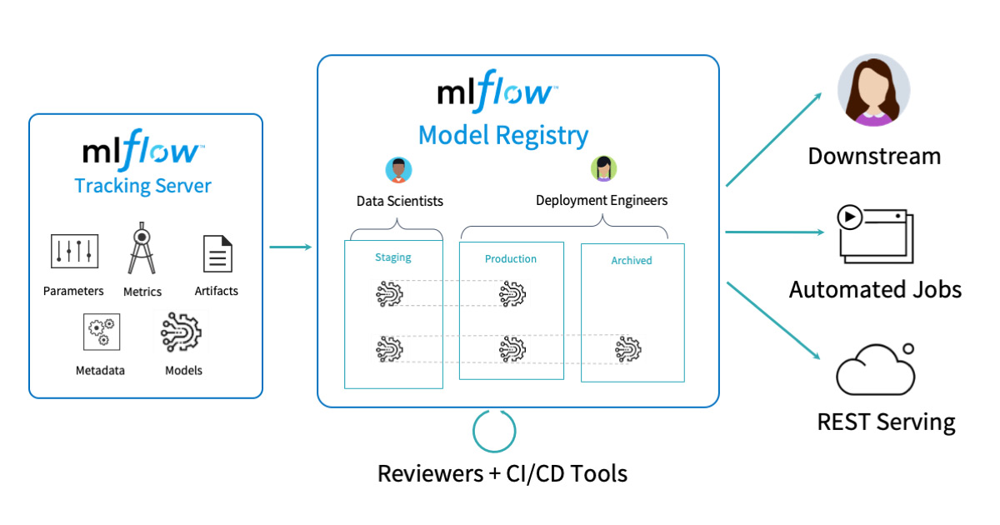
MLflow

Slide 9
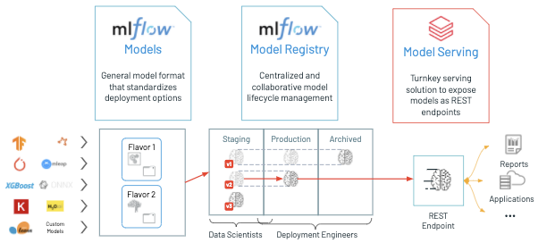
MLflow

Slide 10
What is Managed MLflow?
Managed MLflow on Databricks delivers state-of-the-art experiment tracking, observability, performance evaluation, and model management for the full spectrum of machine learning and AI, from classical models and deep learning to generative AI applications and agents, all natively within the Databricks Data Intelligence Platform.
Managed MLflow is built on the flexible foundation of open-source MLflow and fortified with enterprise-grade reliability, security, and scalability.
This empowers enterprises to confidently build high quality models and agents using their preferred tools across the entire AI & ML ecosystem, all while ensuring their AI and data assets are governed and protected.

Slide 11
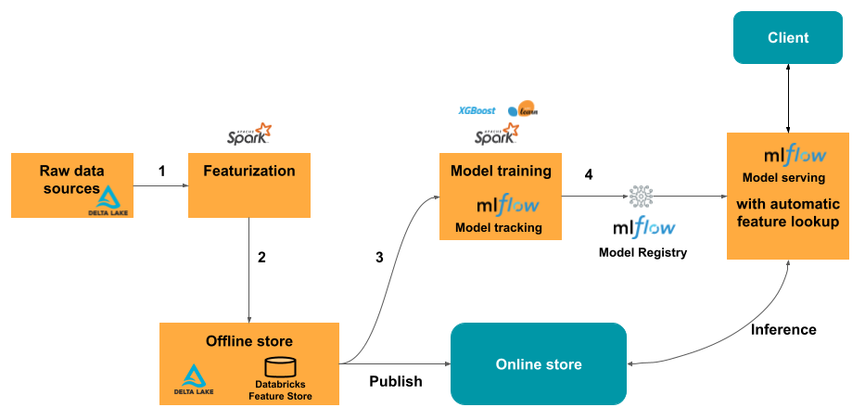
What is Managed MLflow?

Slide 12
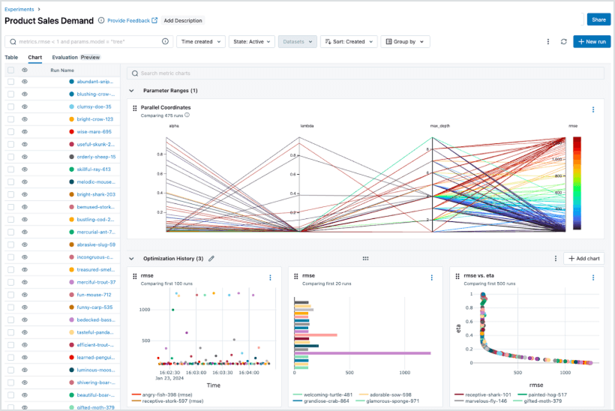
What is Managed MLflow?
Benefits
Unified ML and Gen AI lifecycle
Managed MLflow unifies classical ML, deep learning, and GenAI development in a single, streamlined workflow. From experiment tracking to deployment, it delivers consistent versioning, prompt management, and packaging across models and agents—eliminating the need to stitch together separate tools.

Slide 13
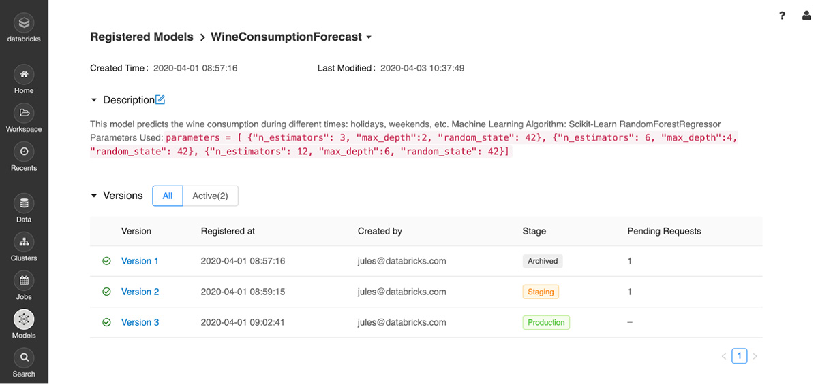
The Model Registry shows different version in different stages throughout their lifecycle.

Slide 14
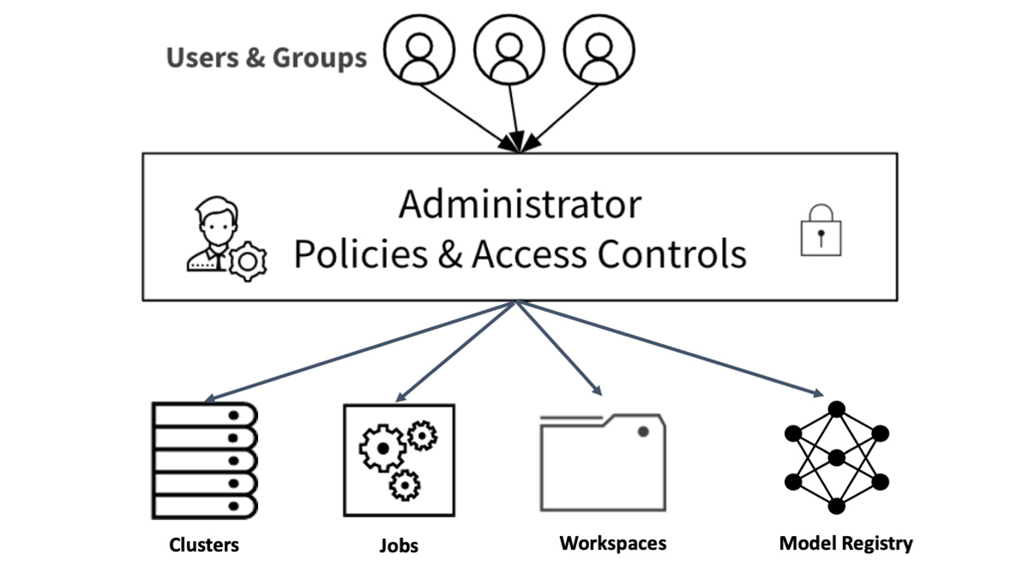
Access Control Policies for Databricks Assets.

Slide 15
Table for Model Registry Access, Abilities and Permissions
As shown in the table in next slide, an administrator can assign four permission levels to models registered in the Model Registry:
No permissions, Read, Edit, and Manage.
Depending on team members’ requirements to access models, you can grant permissions to individual users or groups for each of the abilities shown below.

Slide 16
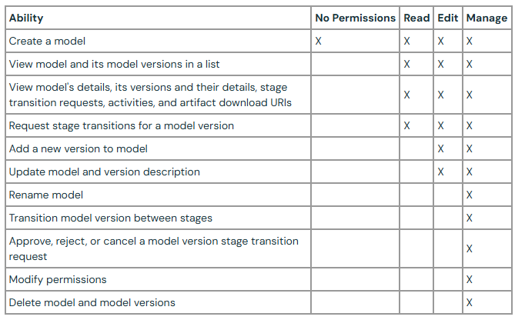
Table for Model Registry Access, Abilities and Permissions

Slide 17
Model Registry UI Workflows
The Model Registry UI is accessible from the Databricks workspace. From the Model Registry UI, you can conduct the following activities as part of your workflow:
Register a model from the Run's page
Edit a model version description
Transition a model version
View model version activities and annotations
Display and search registered models
Delete a model version

Slide 18
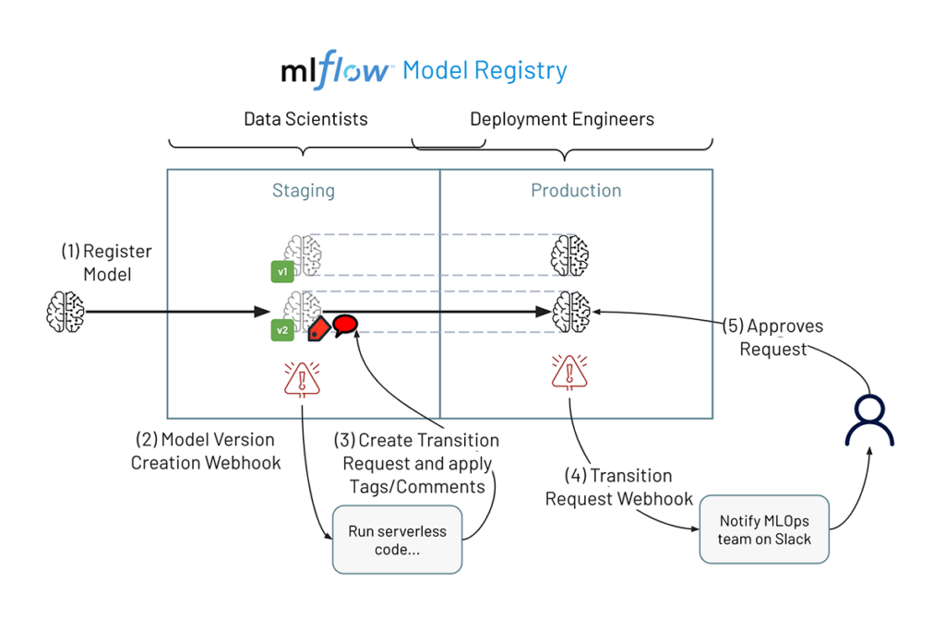
Streamline MLOps With MLflow Model Registry Webhooks

Slide 19
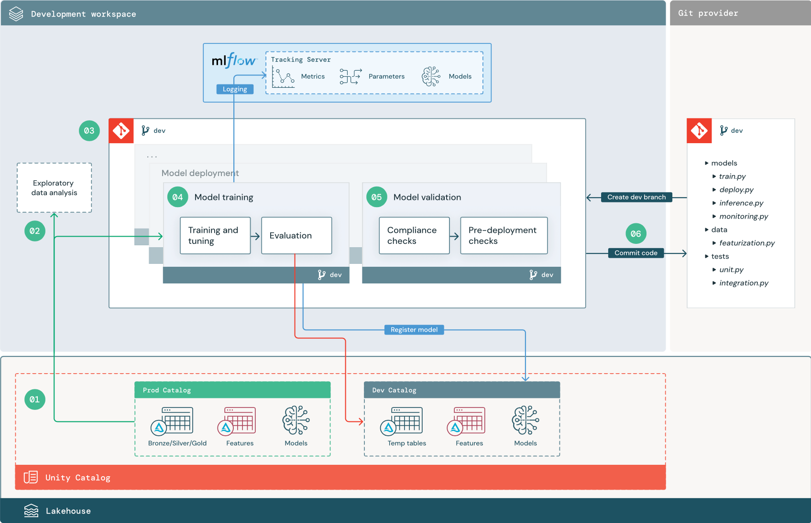
Development stage

Slide 20
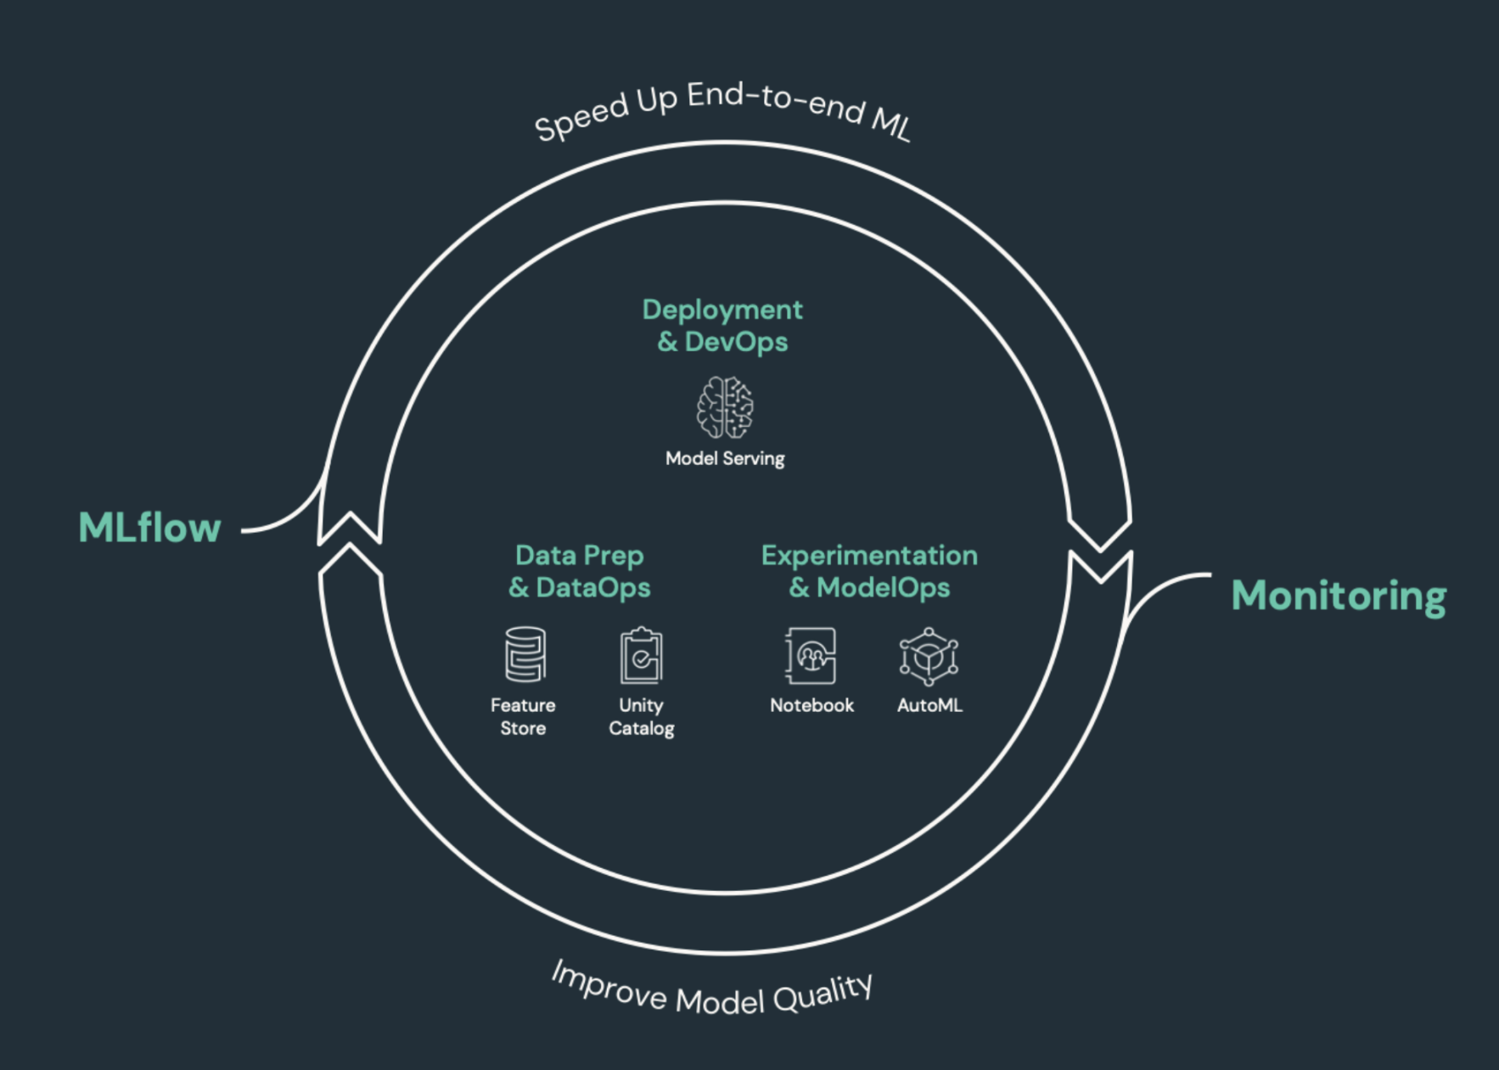
How does Databricks support CI/CD for machine learning?
CI/CD (continuous integration and continuous delivery) refers to an automated process for developing, deploying, monitoring, and maintaining your applications.
By automating the building, testing, and deployment of code, development teams can deliver releases more frequently and reliably than manual processes still prevalent across many data engineering and data science teams.
CI/CD for machine learning brings together techniques of MLOps, DataOps, ModelOps, and DevOps.

Slide 21
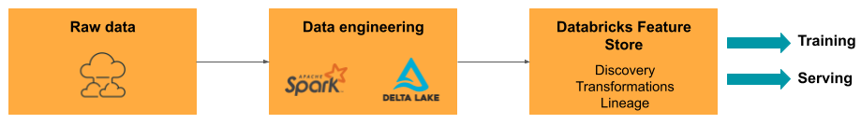
DataOps: Reliable and secure data
Good ML models depend on reliable data pipelines and infrastructure. With the Databricks Data Intelligence Platform, the entire data pipeline from ingesting data to the outputs from the served model is on a single platform and uses the same toolset, which facilitates productivity, reproducibility, sharing, and troubleshooting.

Slide 22
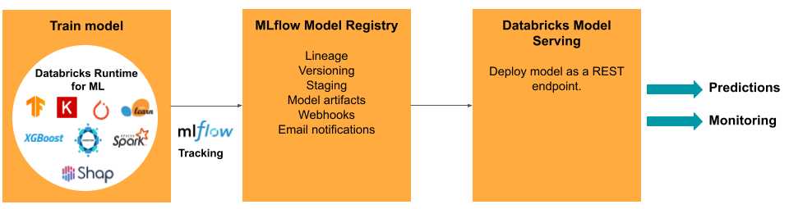
ModelOps: Model development and lifecycle
Developing a model requires a series of experiments and a way to track and compare the conditions and results of those experiments. The Databricks Data Intelligence Platform includes MLflow for model development tracking and the MLflow Model Registry to manage the model lifecycle including staging, serving, and storing model artifacts.

Slide 23

Thanking you !!!

Slide 24
Reference
Extend MLflow Model Registry Features | Databricks Blog
https://www.databricks.com/blog/2020/04/15/databricks-extends-mlflow-model-registry-with-enterprise-features.html
https://docs.databricks.com/aws/en/mlflow/
https://docs.databricks.com/aws/en/machine-learning/mlops/mlops-workflow
https://learn.microsoft.com/en-us/azure/databricks/machine-learning/feature-store/online-feature-stores
https://learn.microsoft.com/en-us/training/modules/deploy-model-managed-online-endpoint/1-introduction

